Slide 1
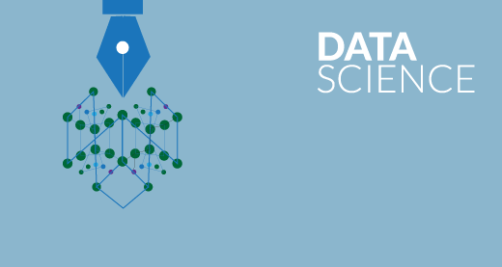
Top 5 Algorithms Used in Data Science

Slide 2




What are we going to learn today ?
At the end of the session you will be able to understand :
What is Data Science
What does Data Scientists do
Top 5 Data Science Algorithms
Decision Tree
Random Forest
Association Rule Mining
Linear Regression
K-Means Clustering
Demo on K-Means Clustering algorithm

Slide 3
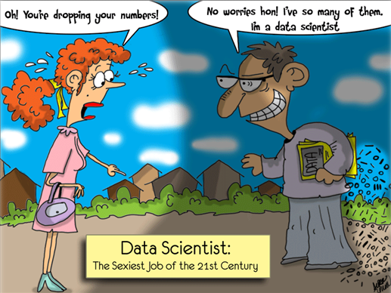
Data Science

Slide 4
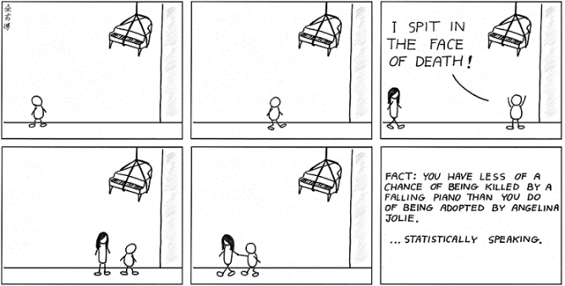
What is Data Science ?
Data science is nothing but extracting meaningful and actionable knowledge from data

Slide 5
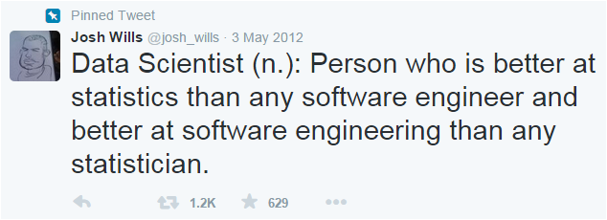
Who are Data Scientists ?
Basically data scientists are humans who have multitude of skills and who love playing with data

Slide 6

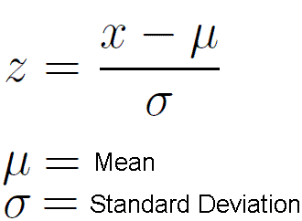

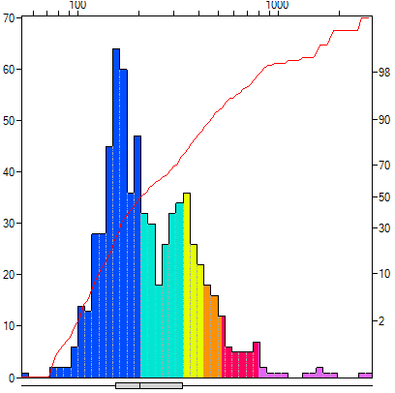

Data Science from 1000 feet
Domain Expertise
Statistics
Data Engineering
Data Science
Visualization
Advanced Computing

Slide 7
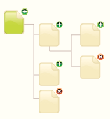
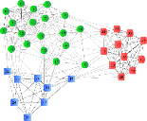
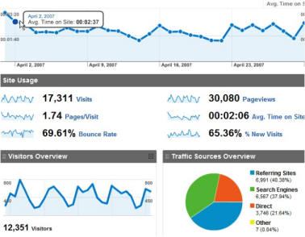

Arsenal of a Data Scientist
Data Science
Data Architecture
Machine Learning
Analytics
Tool: Hadoop
Tool: Mahout, Weka, Spark MLlib
Tool: R, Python
Note that evaluating different machine learning algorithms is a daily work of a data scientist. So it becomes very important for a data scientist to have a good grip over various machine learning algorithms.

Slide 8
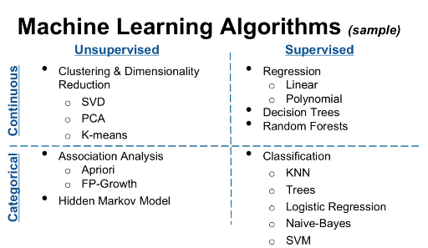
Machine Learning
Machine Learning is a method of teaching computers to make and improve predictions based on data
Machine learning is a huge field, with hundreds of different algorithms for solving myriad different problems
Supervised Learning : The categories of the data is already known
Unsupervised Learning : The learning process attempts to find appropriate category for the data

Slide 9
Decision Tree
Decision Tree

Slide 10
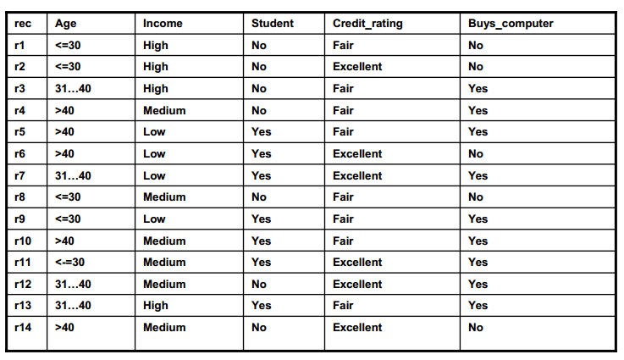
Decision Tree Example
Training
Data

Slide 11
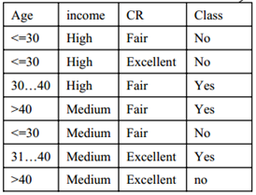
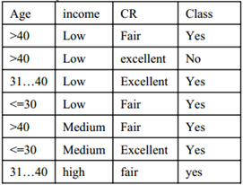
Decision Tree, Root : Student
Step-1
Student
NO
YES

Slide 12
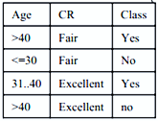
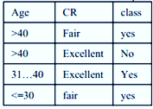

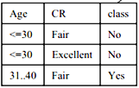

Decision Tree, Root : Student
Step-2
Student
No
Yes
Income
Income
Low
High
High
Medium
Medium

Slide 13
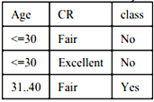
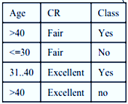
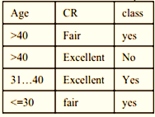
Decision Tree, Root : Student
Step-3
Student
No
Yes
Income
Income
High
Medium
Low
High
Medium
YES
YES

Slide 14






Decision Tree, Root : Student
Step-4
Student
No
Yes
Income
Income
High
Medium
High
Low
Medium
Age
CR
< = 30
Fair
Excellent
CR
31….40
Fair
YES
YES
Excellent

Slide 15



Decision Tree, Root : Student
Step-5
Student
No
Yes
Income
Income
High
Medium
High
Low
Medium
Age
CR
CR
< = 30
Fair
Yes
31….40
Yes
Excellent
Excellent
Fair
Yes
No
Yes

Slide 16
Decision Tree, Root : Student
Step-6
Student
No
Yes
Income
Income
High
High
Medium
Low
Age
CR
Medium
< = 30
Fair
Excellent
CR
Yes
Yes
31….40
Excellent
Age
Fair
Yes
No
> 40
31….40
Yes
Age
No
Age
Yes
31….40
> 40
< = 30
> 40
Yes
No
Yes
No

Slide 17
Decision Tree, Root : Student
Classification rules :
1. student(no)^income(high)^age(<=30) => buys_computer(no)
2. student(no)^income(high)^age(31…40) => buys_computer(yes)
3. student(no)^income(medium)^CR(fair)^age(>40) => buys_computer(yes)
4. student(no)^income(medium)^CR(fair)^age(<=30) => buys_computer(no)
5. student(no)^income(medium)^CR(excellent)^age(>40) => buys_computer(no)
6. student(no)^income(medium)^CR(excellent)^age(31..40) =>buys_computer(yes)
7. student(yes)^income(low)^CR(fair) => buys_computer(yes)
8. student(yes)^income(low)^CR(excellent)^age(31..40) => buys_computer(yes)
9. student(yes)^income(low)^CR(excellent)^age(>40) => buys_computer(no)
10. student(yes)^income(medium)=> buys_computer(yes)
11. student(yes)^income(high)=> buys_computer(yes)

Slide 18
Random Forest
Random Forest

Slide 19
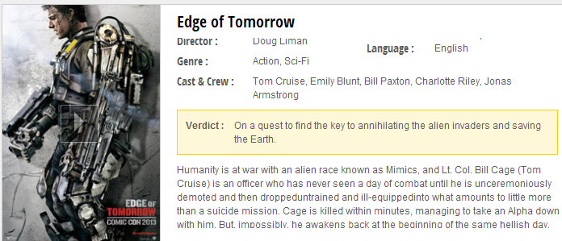
Random Forest : Example
Suppose you're very indecisive about watching a movie.
“Edge of Tomorrow”
You can do one of the following :
Either you ask your best friend, whether you will like the movie.
Or You can ask your group of friends.

Slide 20
Random Forest : Example
Ask
Best Friend
In order to answer, your best friend first needs to figure out what movies you like, so you give her a bunch of movies and tell her whether you liked each one or not (i.e., you give her a labelled training set)
Example:
Do you like movies starring Emily Blunt ?
Is it based on a true incident?
Does Emily Blunt star in it?
No
Is she the main lead?
No
Yes
No, You will not like the movie
No, You will not like the movie
Yes, You will like the movie

Slide 21
Random Forest : Example
But your best friend might not always generalize your preferences very well (i.e., she overfits)
In order to get more accurate recommendations, you'd like to ask a bunch of your friends e.g. Friend#1, Friend#2, and Friend#3 and they vote on whether you will like a movie
The majority of the votes will decide the final outcome

Slide 22
Random Forest : Example
Friend 1
Friend 2
Friend 3
You did not like ‘Top Gun’
You loved ‘Godzilla’
You didn’t like ‘Far and away’
You liked ‘Oblivion’
You hate Tom Cruise
No, You will not like the movie
Yes, You will like the movie
Yes, You will like the movie
You like Tom Cruise
No, You will not like the movie
You like action movies
You like his pairing with Emily Blunt
Yes, You will like the movie
Yes, You will like the movie

Slide 23
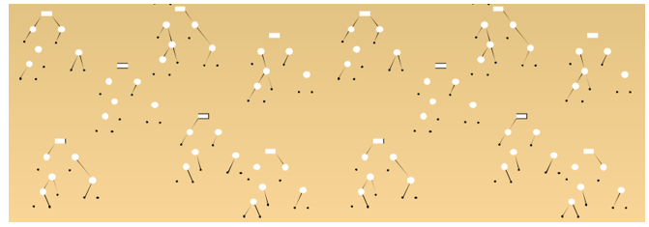
What is Random Forest ?
Random Forest is an ensemble classifier made using many decision tree models.
What are ensemble models?
Ensemble models combine the results from different models.
The result from an ensemble model is usually better than the result from one of the individual models.

Slide 24
Association Rule Mining
Association Rule Mining

Slide 25
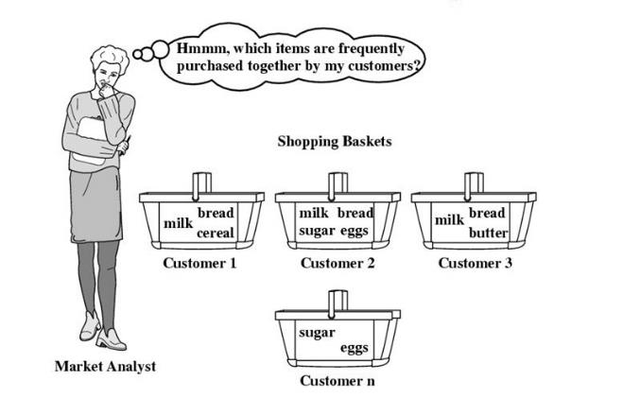
Association Rule Mining

Slide 26
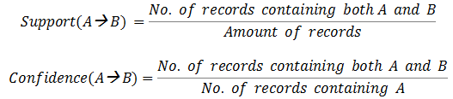
Association Rule Mining
Association Rule Mining is a popular and well researched method for discovering interesting relations between variables in large data.
The rule found in the sales data of a supermarket would indicate that if a customer buys onions and potatoes together, he or she is likely to also buy hamburger meat.

Slide 27
Linear Regression
Linear Regression

Slide 28
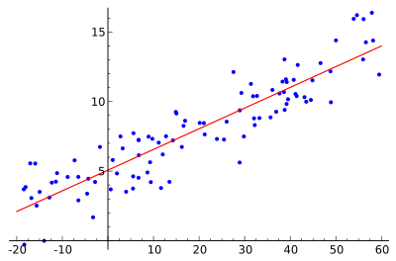
Regression Analysis – Linear Regression
Regression analysis helps understand how value of dependent variable changes when any one of independent variable changes, while other independent variables are kept fixed
Linear Regression is the most popular algorithm used for prediction and forecasting

Slide 29
K-Means Clustering
K-Means Clustering

Slide 30

K-Means Clustering
Total population
The process by which objects are classified into a number of groups so that they are as much dissimilar as possible from one group to another group, but as much similar as possible within each group.
The objects in group 1 should be as similar as possible.
But there should be much difference between objects in different groups
The attributes of the objects are allowed to determine which objects should be grouped together.
Group 2
Group 3
Group 1
Group 4

Slide 31

Hands-On
Demo K-Means Clustering

Slide 32
Thank You …
Questions/Queries/Feedback
Recording and presentation will be made available to you within 24 hours

